Slide 1
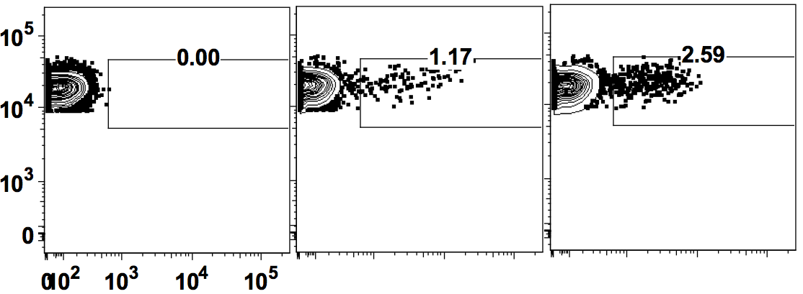
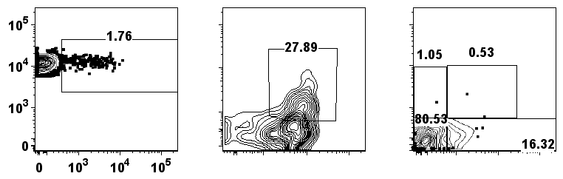
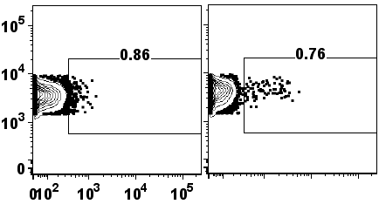
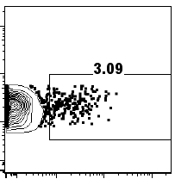
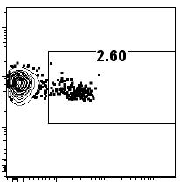
FIGURE 1
a
B6.IL21-VFP
B6
2 wk
4 wk
CD4
VFP
b
c
CD4
ICOS
PD1
VFP
CD44
CXCR5
d
B6.IFNγ-YFP
B6.IL10-GFP
B6.IL21-VFP
B6.FoxP3-GFP
CD4
Reporter
Notes:
LOOK AT HISTOGRAM OF VFP for spleen vs thymus

Slide 2
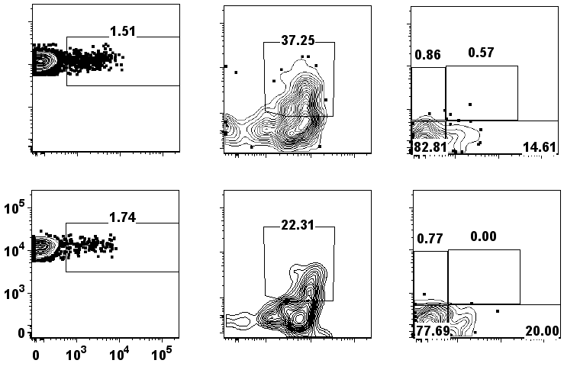
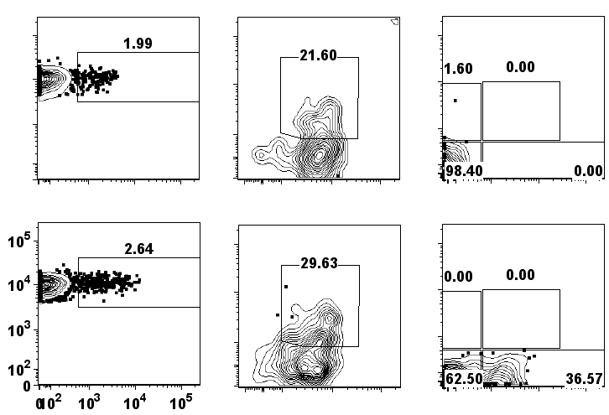
FIGURE 2
a
Ighm-/- IL21-VFP
b
Cxcr5-/- IL21-VFP
IL21-VFP
IL21-VFP
CD4
ICOS
PD1
CD4
ICOS
PD1
VFP
CD44
CXCR5
VFP
CD44
CXCR5
c
d
Notes:
Combine knockout and reporter data. Put reporter data first. Add FoxP3. Look at FoxP3 in the thymus. Genes and cytokines that drive them.

Slide 3
FIGURE 3
a
b
c
N2
N1
8 day N CD4T
8 day TH1 R2
8 day TH1 R1
ACT1
ACT2
8 day TFH2
8 day TFH1
8 day GCTFH2
8 day GCTFH1
IL21-ACT1
IL21-ACT2
Functional enrichment
Ribosome (9) Prostate cancer (4)
Cytokine-cytokine receptor interaction (15) Leishmaniasis (5) Chemokine signaling pathway (8) Natural killer cell mediated cytoxicity (6) Protein processing in endoplasmic reticulum (7) Endocytosis (7)
T cell receptor signaling pathway (9) Fc epsilon Rl signaling pathway (6) Fc gamma R-mediated phagocytosis (6) VEGF signaling pathway (5) Neurotrophin signaling pathway (6) Inositol phosphate metabolism (4) GnRH signaling pathway (5) Glioma (4) Leukocyte transcendothelial migration (5) Chemokine signaling pathway (6)
Il21
Gpm6b
Tox2
N (149)
Maf
Sostdc1
Ifng
Nkg7
Tbx21
ACT (165)
Tcf7
Bcl6
ACT IL21 vs N
Prdm1
Il6ra
Il21r
IL21-ACT2
IL21-ACT1
3 day TFH2
3 day TFH1
3 day TH1 R2
3 day TH1 R1
ACT1
ACT2
N2
N1
Foxp1
Lef1
Foxo1
N
ACT
ACT IL21
ACT IL21 (158)
Il2ra
Foxp3
-1 0 1
ACT vs N
d
e
100
100
80
80
60
60
% of total TPM
% of total TPM
40
Bcl6
E2f2
Id3
Fosb
Tox
Tox2
Egr2
Maf
Nfatc1
Pou2af1
Tcf7
Lef1
Prdm1
Foxp1
Foxo1
40
20
20
0
Il21
Tnsf8
Tgfb3
Angptl2
Il6ra
Il6st
Il21r
0
Sostdc1
Cxcr5
Btla
Cd200
Slamf6
Gpm6b
Mki67
Cdc25b
Ccdc12
Ccdc28b
Tbc1d4
Myo1g
Ifng
Tbx21
Id2
Gzmb
Il12rb2
Il18rap
Foxp3
Il2ra
Il21rb
Tnfrsf18
Cd4
Cd28
Lag3
Il4
Gata3
Asb2
Klrg1
Serpina3g
Ccl5
Tx Factors
Cytokines/
Receptors
Markers
TCR/CD3
Cell Cycling
TH₁
TH₂
NKT
T_{reg}
Notes:
Figure 3. Functional enrichment in panel b: KEGG terms with p-values less than 0.01.

Slide 4
FIGURE 4
Trav10
Trav10d
Trav11
Trav11d
Trav12−2
Trav12−3
Trav12d−3
Trav12n−3
Trav13−1
Trav13−4−dv7
Trav14−1
Trav14−2
Trav14−3
Trav14d−1
Trav14d−2
Trav14d−3−dv8
Trav14n−1
Trav14n−2
Trav14n−3
Trav16
Trav16n
Trav17
Trav3−3
Trav4−2
Trav4−4−dv10
Trav5−4
Trav6−5
Trav6−6
Trav6−7−dv9
Trav7−2
Trav7−3
Trav7−4
Trav7−6
Trav7d−3
Trav7d−4
Trav7d−5
Trav8−1
Trav8−2
Trav9−1
Trav9−2
Trav9−4
Trav9d−1
Trbv12−2
Trbv13−2
Trbv13−3
Trbv15
Trbv16
Trbv19
Trbv2
Trbv20
Trbv29
Trbv3
Trbv31
Trbv4
Trbv5
a
N
-0.004
TPM
ACT
0.866
0.076
nT_{FH}
b
TCRα -/- OT2
IL21-VFP
IL21-VFP
VFP
CD4
ICOS
Notes:
Fig 4 repertoire

Slide 5
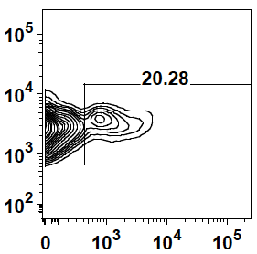
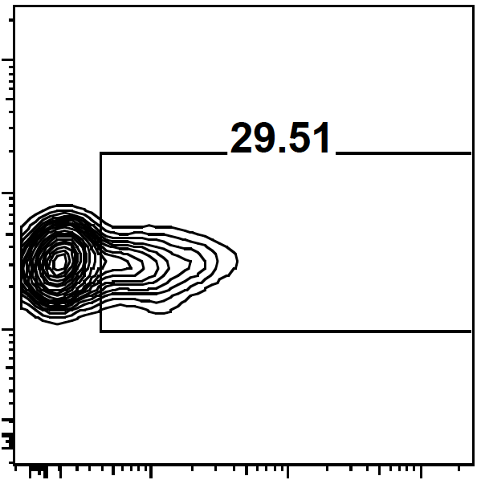
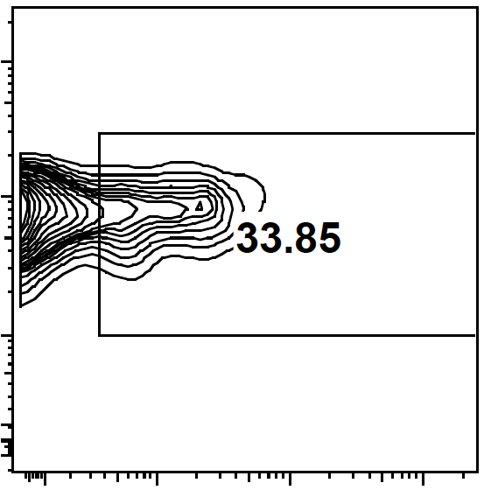
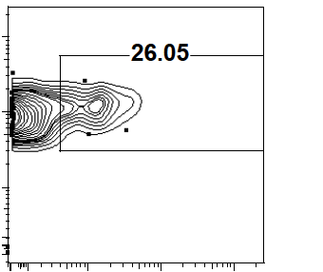
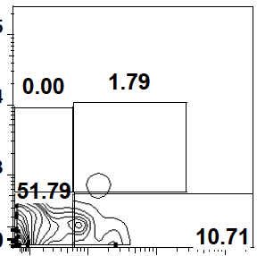
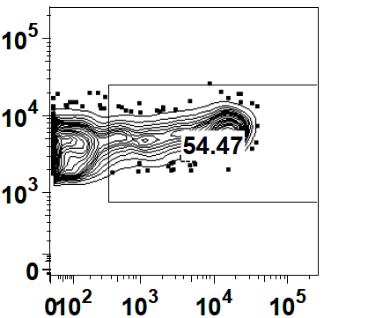
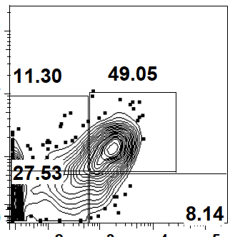
FIGURE 5 – Adoptive Transfer Data
a
2 wks
4 wks
6 wks
CD4
VFP
b
c
d
Unimmunized
Immunized
PD1
CD4
VFP
CXCR5
Notes:
Figure 5. Adoptive transfer

Slide 6
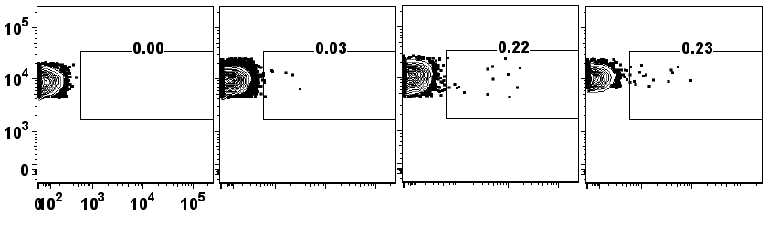
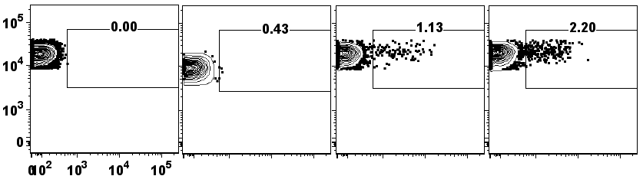
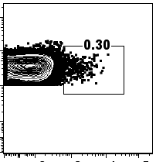
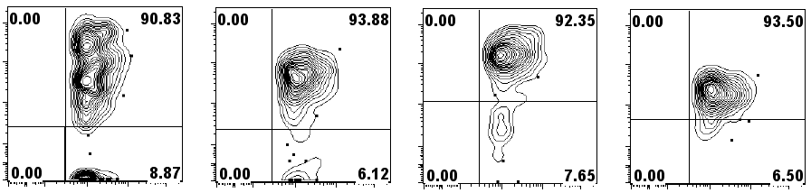
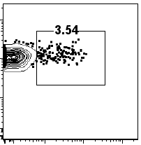
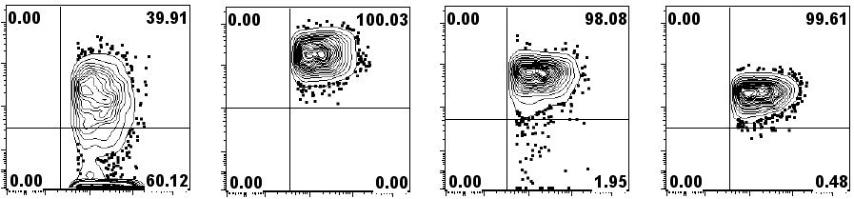
FIGURE 6 - Thymus
a
B6.IL21-VFP
b
c
B6
2 day
2 wk
4 wk
Thymus
B6
2 day
2 wk
4 wk
Spleen
CD4
VFP
d
ICOS
CD44
CD5
CD3e
Thymus
Spleen
CD4
ICOS
CD44
CD5
CD3e
VFP
VFP
e
Notes:
Figure 6. Thymus Histogram graph? Look at the activation profile of spleen and thymus and compare. Lymph node spleen and blood. No thymus. CFSE labeled. Thymic vs non thymic cells. Present transfer data that is pertinent to the thymus argument

Slide 7
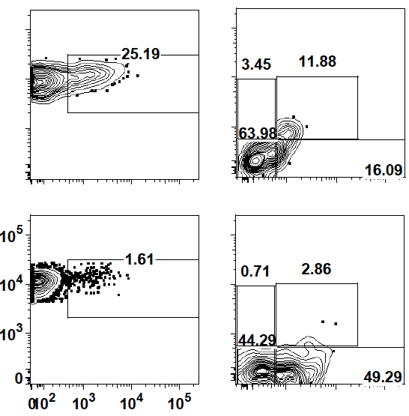
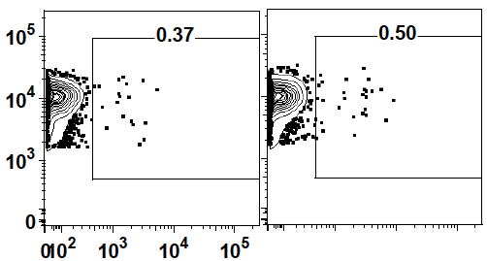
FIGURE 7
a
Thymus
b
Spleen
c
Foxp3-/- IL21 VFP
d
IL21 VFP
CD4
PD1
VFP
CXCR5
e
FoxP3-/-
IL21-VFP
IL21-VFP
CD4
VFP
Notes:
Figure 7.

